Slide 1

Enron North America

Slide 2
Enron North America
Leading Provider of Energy in North America
Unparalleled Energy Network and Product Offerings
Significantly Benefiting from Changes in Energy Markets
Further Expanding Market Presence through e-Commerce

Slide 3
Key Markets
Natural Gas
Power
Coal
Crude Products
Emissions
Weather
Pulp and Paper
Merchant
Investments
Profit Opportunities Exist Within and Between Markets
Scale and Information Identify Highest Value Opportunities
Low Incremental Cost to Enter New Markets
Diversification Contributes to Strong Business Growth

Slide 4
Key Markets
Natural Gas
Power
Coal
Crude Products
Emissions
Weather
Pulp and Paper
Merchant
Investments

Slide 5
North America
Wholesale Gas Market
Structural Changes in Wholesale Power Demand Patterns Providing Exceptional Gas-Related Opportunities
High Premiums Earned for Flexibility and Services
Opportunities in Outsourcing Energy Assets and Supply
e-Commerce Applications Differentiating Competitors

Slide 6
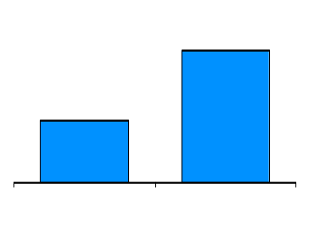
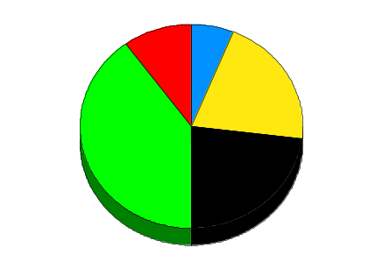
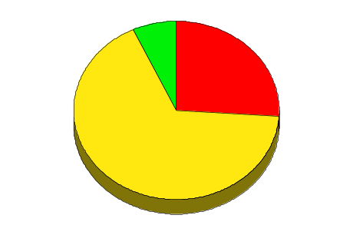
Enron’s Wholesale Gas Network
Storage Capacity
(Bcf)
52
28
Leased
Owned
Counterparties
Manufacturing
Marketers
Producers
Utilities
Others
Henry
Henry
Henry
Henry
Hub
Hub
Hub
Hub
Contract Term
Marketing Offices
Owned and Leased Capacity
NYMEX
Owned Gas Storage
Leased Storage
<1Yr
1-10 Yr
>10Yr
Gas Marketing Activity

Slide 7
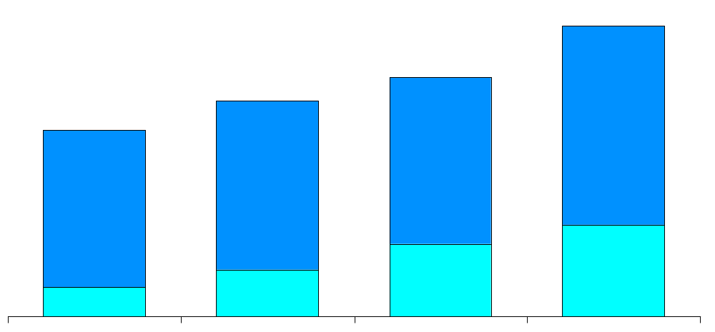
Natural Gas
Physical Volumes
(BBtu/d)
United States
Canada
13,955
11,463
10,377
8,948
22%
1996
1997
1998
1999

Slide 8
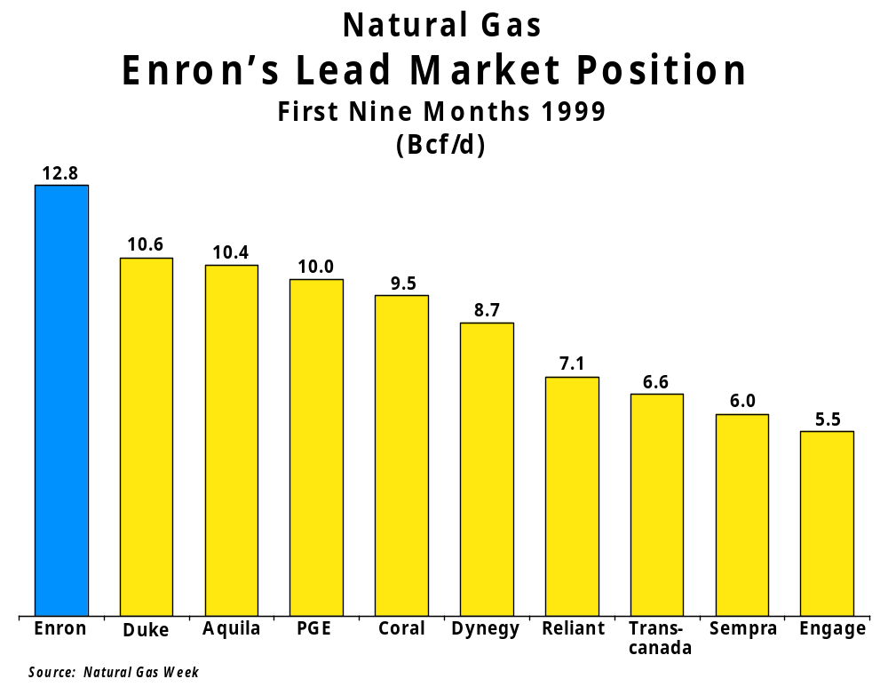

Slide 9
Key Markets
Natural Gas
Power
Coal
Crude Products
Emissions
Weather
Pulp and Paper
Merchant
Investments

Slide 10
North America
Wholesale Power Market
Deregulation Provides Enormous Opportunities
  Divesting of Generation Assets
  Access to Industrial Energy Load
Further Changes in Regulatory Environment will Facilitate Access to Utility Territories
Customers Need Price Risk Management Services to Compete More Effectively

Slide 11
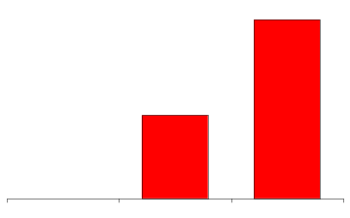
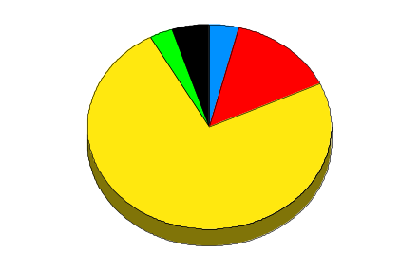
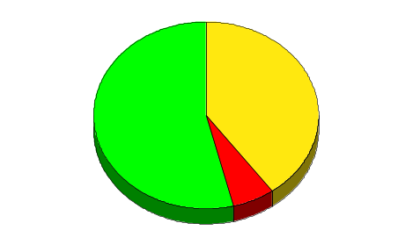
Enron’s Wholesale Power Network
Peaking Generation
(MW)
2,800
1,300
MAPP
MAIN
0
ECAR
NPCC
1998
1999
2000E
ComEd
Hub
COB
PJM
Hub
Hub
MAAC
Cinergy
Cinergy
Cinergy
Hub
Hub
Hub
Counterparties
Cinergy
WSCC
Hub
SPP
Manufacturing
Marketers
SERC
Utilities
Palo
Palo
Palo
Municipal
Palo
Verde
Verde
Verde
Verde
Hub
Hub
Hub
Others
Hub
TVA
Hub
Entergy
Entergy
Entergy
Hub
Hub
ERCOT
Hub
Contract Term
Marketing Offices
NYMEX
Marketing Hub
FRCC
<1Yr
1-5Yr
>5Yr
Power Plants
In Operation
Under Development
Power Marketing Activity
Transmission Grid

Slide 12
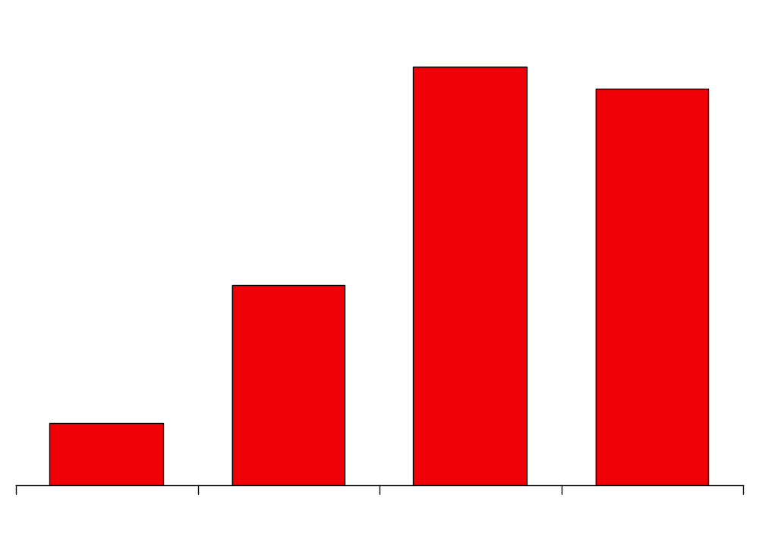
Power
Physical Volumes
(Million MWh)
402
381
192
60
1996
1997
1998
1999

Slide 13
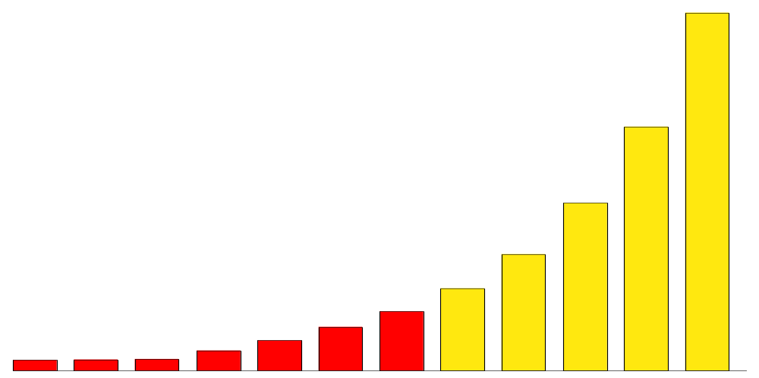
North America Non-Regulated Power Market
(Million MWh)
18,000
14,500
11,000
8,000
5,000
3,450
3,359
1,556
2,306
819
863
908
1993
1994
1995
1996
1997
1998
1999E
2000E
2001E
2002E
2003E
2004E
39% Projected Growth Rate

Slide 14
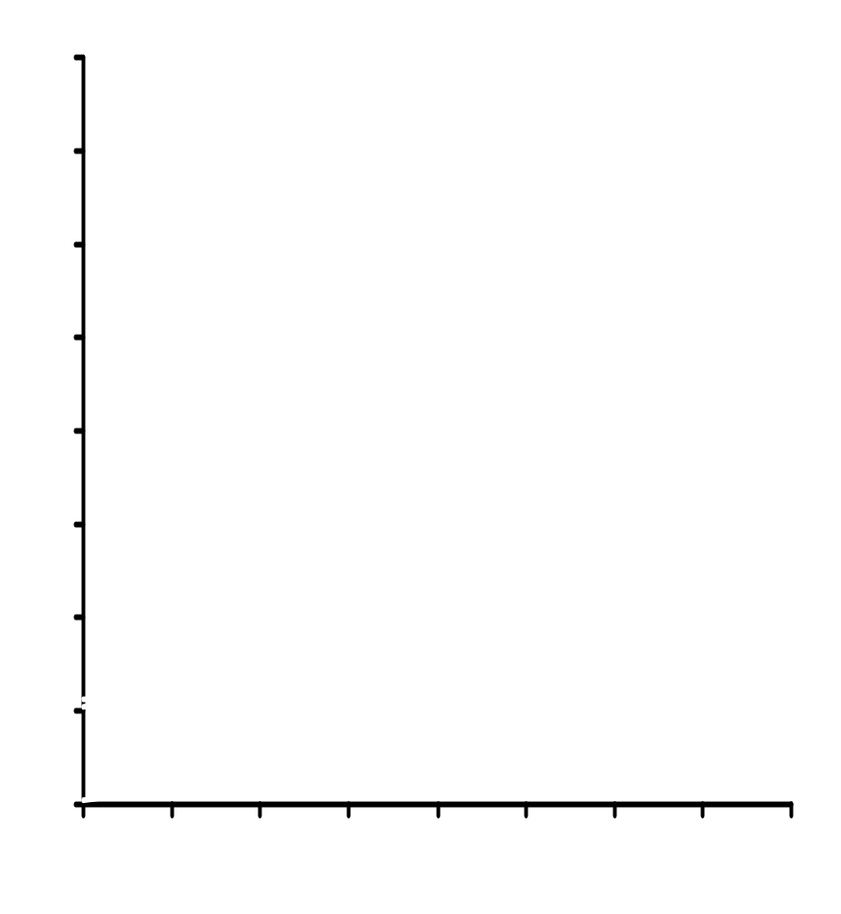
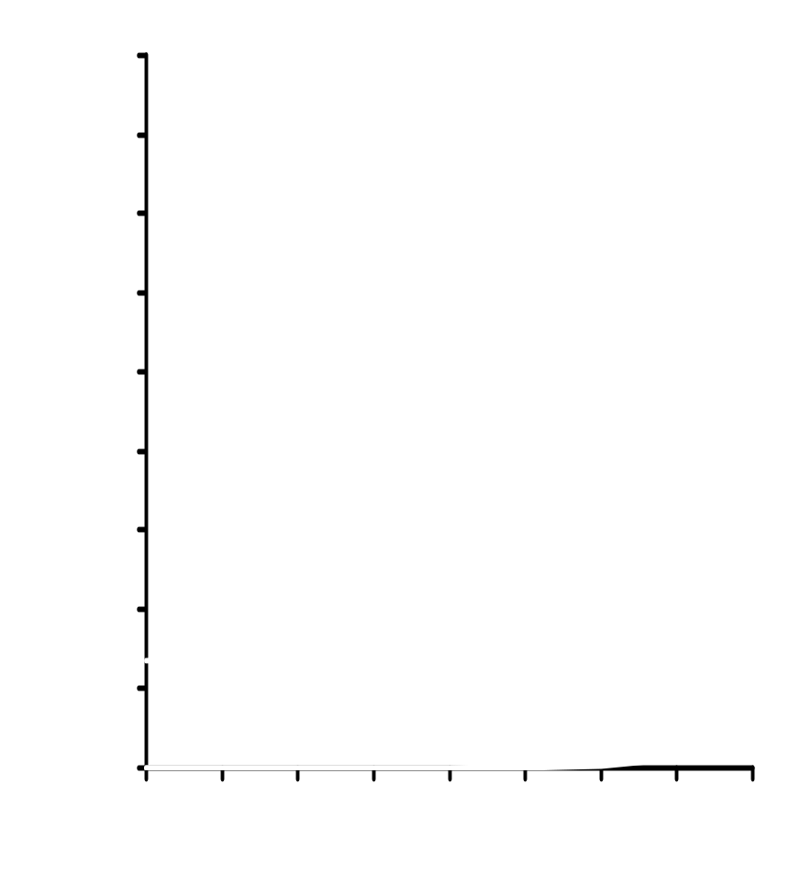
North America
Power Market Offers Significant Growth Prospects
Gas
(Bcf/d)
Power
(Million MWh)
400
18,000
Futures
300
14,000
10,000
200
Wholesale
6,000
100
Delivered
Wholesale
Delivered
2,000
0
0
Futures
1990
1991
1992
1993
1994
1995
1996
1997
1998
1990
1991
1992
1993
1994
1995
1996
1997
1998
Source: EIA Electric Power Annual; EIA Natural Gas Monthly; McGraw-Hill

Slide 15
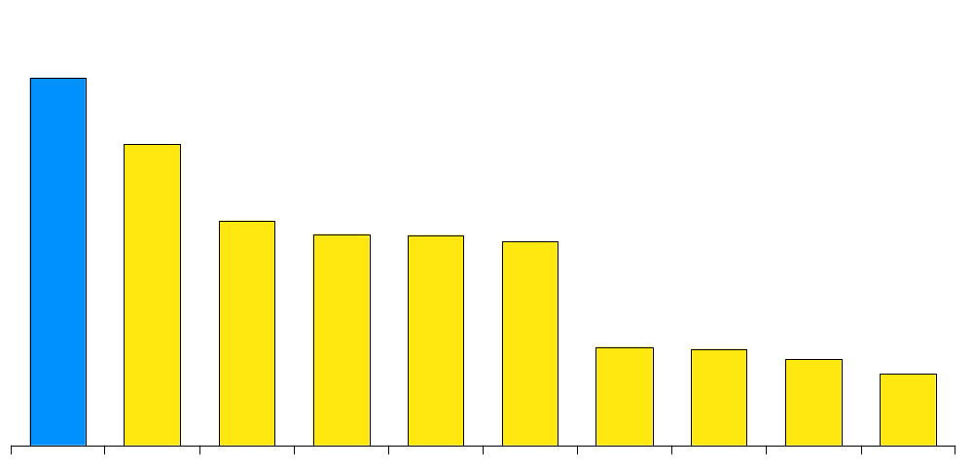
Enron’s Lead Power Market Position
First Nine Months 1999
(Million MWh)
292
240
179
168
167
162
78
77
68
57
Enron
AEP
Aquila
Avista
PG&E
Southern
Duke
Reliant
Citizens
Williams
Source: Natural Gas Week

Slide 16
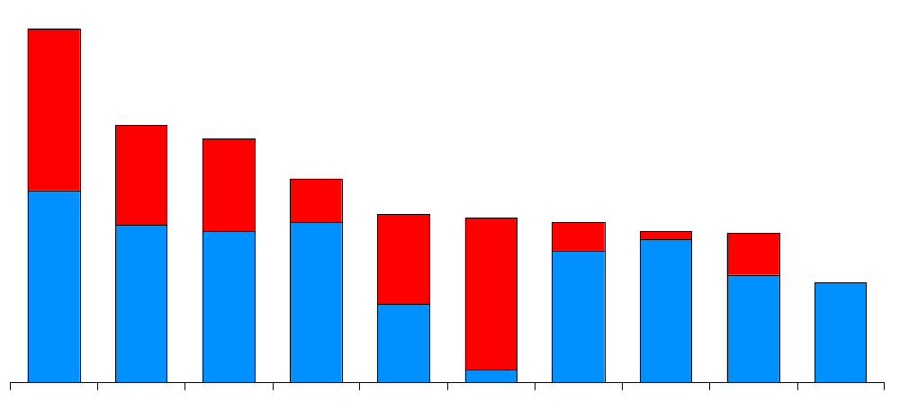
Natural Gas and Power Volumes
Enron’s Lead Market Position
First Nine Months 1999
(TBtue/d)
23.4
17.0
16.1
13.5
11.1
10.9
10.6
10.0
9.9
6.6
Enron
Aquila
PG&E
Duke
Southern
AEP
Dynegy
Coral
Reliant
TransCanada
Gas
Power

Slide 17
Key Markets
Natural Gas
Power
Coal
Crude Products
Emissions
Weather
Pulp and Paper
Merchant
Investments

Slide 18
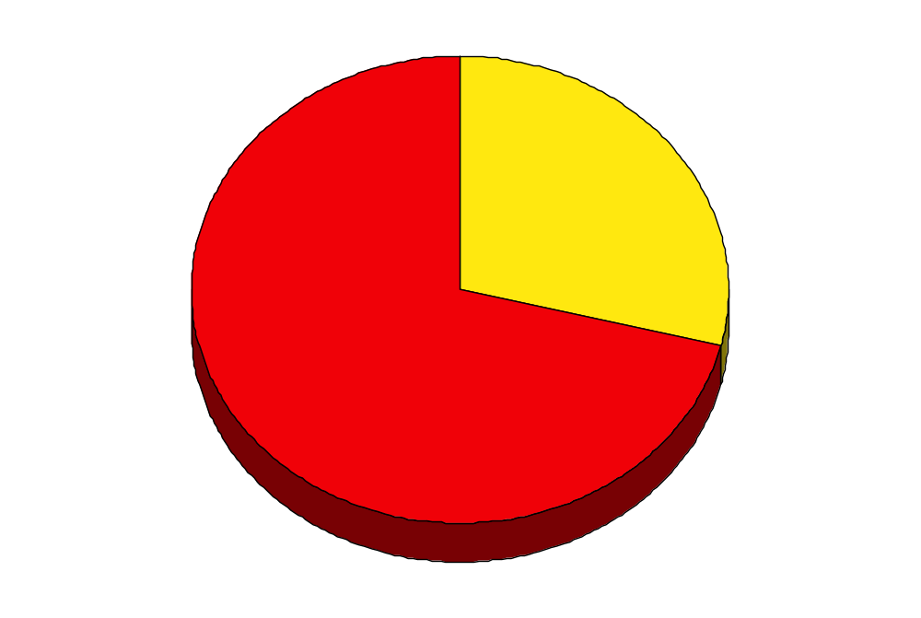
Enron’s Merchant Investments
Portfolio by Industry
Extension of Products Provided to Customers
Comprises Equity and Debt Investments in Energy-Related Businesses
Capital and Finance Expertise Leverages Enron’s Position in Energy-Related Markets
Investments can Include Board Representation
Pulp & Paper, Steel and Other
Energy
$1.5 Billion Value as of 12/31/99

Slide 19
Key Markets
Natural Gas
Power
Coal
Crude Products
Emissions
Weather
Pulp and Paper
Merchant
Investments

Slide 20
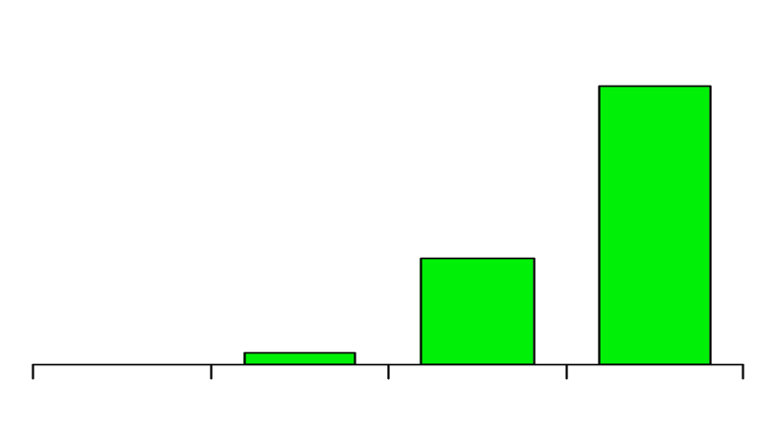
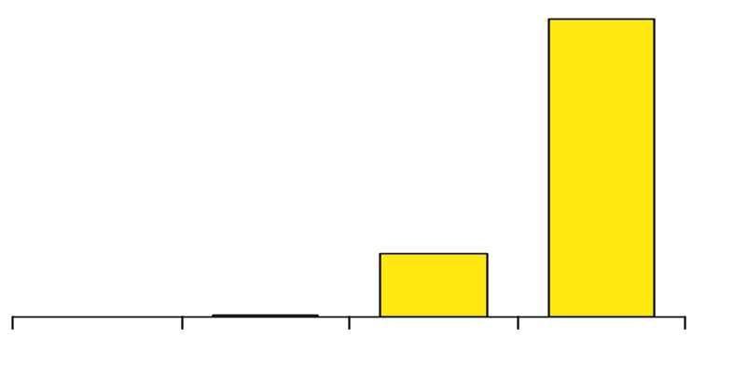
Coal
Market Developments
Enron’s Transactions
Coal Fuels 57% of U.S. Generation
Changing Regulations Create Market Uncertainty and Opportunities for Enron
Increased Competition Demands Price Certainty and Supply Flexibility
Forward Market Developing
715
250
0
46
Enron’s Coal Business
1996
1997
1998
1999
Customers Include Coal Producers, Generators and Utilities
Providing Comprehensive Management Services
  Physical Delivery
  Price and Volume Risk Management
  Investment Capital
Market Maker for Emissions Credits
Largest Wholesale Marketer of Coal in U.S.
Enron’s Volumes
(Thousand Tonnes)
26,732
5,589
0
21
1996
1997
1998
1999

Slide 21
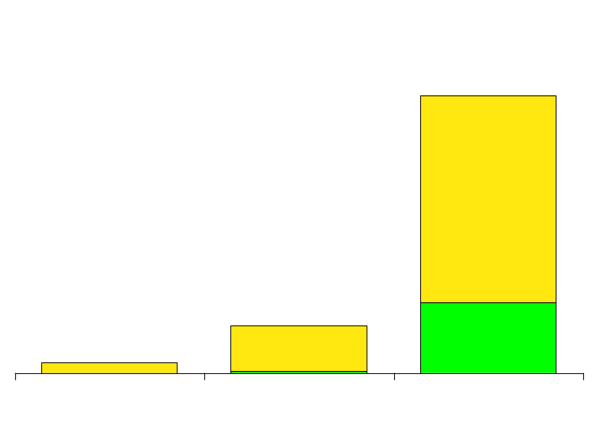
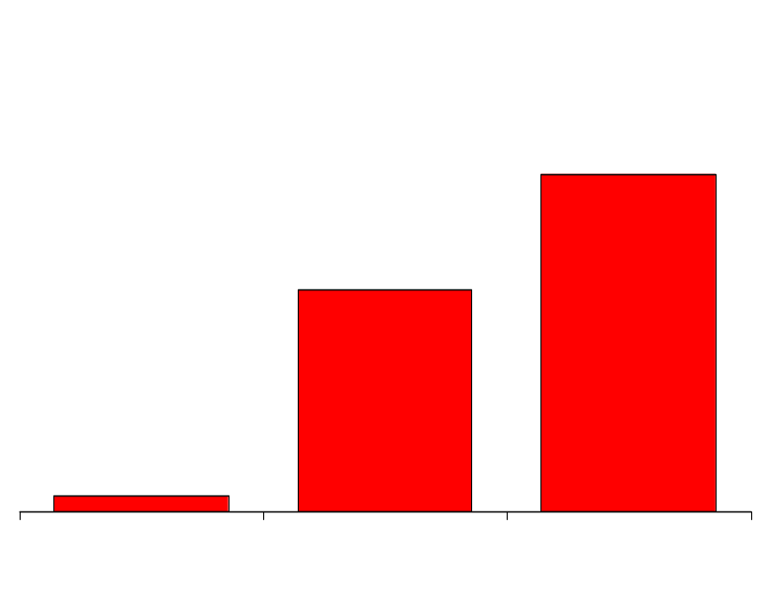
Pulp and Paper
Market Developments
Enron’s Transactions
432
Industry Experiences Extreme Price Volatility
Price Uncertainty Results in Inefficient Capital Structures
Financial
Physical
Enron’s Pulp & Paper Business
73
17
Lead Provider in U.S. of Risk Management Services
Providing Structured Customized Solutions
  Energy Commodities
  Risk Management Products
1997
1998
1999
Enron’s Notional Volumes (Thousand Tonnes)
6,868
4,507
Serving Large, Energy-Intensive Industrial Customers
314
1997
1998
1999

Slide 22
Enron North America
Leading Provider of Energy in North America
Unparalleled Energy Network and Product Offerings
Significantly Benefiting from Changes in Energy Markets
Further Expanding Market Presence through e-Commerce

Slide 23
Enron North America
Natural Gas
Power
Coal
Crude Products
Emissions
Weather
Pulp and Paper
Merchant
Investments

Slide 24
Peoples Energy
Natural Gas
Power
Coal
Crude Products
Emissions
Weather
Pulp and Paper
Merchant
Investments
Long Term Gas
Supply
Hub
Services
Wholesale
Electric Supply
Supply Peoples’ Natural Gas
Requirements
  - 5 Year Term
  - 270 MMcf/d
  - 10% of Natural Gas
  Consumed in Chicago
Enron
Marketing
Risk Management
National Reach
Peoples
Storage Assets
Transportation
Regional Expertise
Provide Key Services
to Peoples’ Retail Power
Markets
- Wholesale Power Supply
- Risk Management
Target Market Area
Representing 5% of U.S.
Natural Gas Consumed
Increase Liquidity & Flexibility
at Chicago City Gate
- Access Multiple Supply
Basins
- Interconnect With 6 Major
Pipelines
  Acquire and Optimize
  Transport Capacity Within Enron’s Broader Portfolio
  Provide Weather Risk Management Services

Slide 25
The United Illuminating
Company (U.I.)
Natural Gas
Power
Coal
Crude Products
Emissions
Weather
Pulp and Paper
Merchant
Investments
Long-Term Power Outsourcing for Major Northeastern Utility Serving 314,000 Customers
Assumes and Optimizes U.I.’s Power Purchase Agreements
Significantly Increases Enron’s Power Portfolio
Facilitated by Unparalleled Capabilities
  Load Forecasting, Volume Management and Superior Systems
Significant Opportunities in Managing Full Requirements Power Contracts

Slide 26
Power Generation –
Peaking Plants
Natural Gas
Power
Coal
Crude Products
Emissions
Weather
Bismark
Pulp and Paper
Merchant
Investments
1,300 MW Peaking Capacity Developed and Constructed in Less than 12 Months
  Utilized Resources Across Enron’s Networks
  Commissioned June 1999
1,500 MW Peaking Capacity in Construction
  Strategic Locations
  Commercial Operation Due Mid-Year 2000
Sites for Additional 1,500 MW Peaking Capacity under Development
Lincoln, IL
ComEd
Hub
Cinergy Hub
Denver
West Fork, IN
Gleason, TN
Brownsville, TN
New Albany, MS
TVA
Entergy Hub
Caledonia, MS
Caledonia
, MS
In Operation
Nymex
In Development and Construction
Marketing Hubs
Provides Reliability of Supply at Known Cost and Increases Power Portfolio Flexibility
1999 Peaker Timeline
July 98
Sept 98
Feb 99
May 99
June 99
Identified
Market
Opportunity
Sites Permitted
& Began Construction
Gas Turbines
Delivered
Testing
Commercial Operations

Slide 27
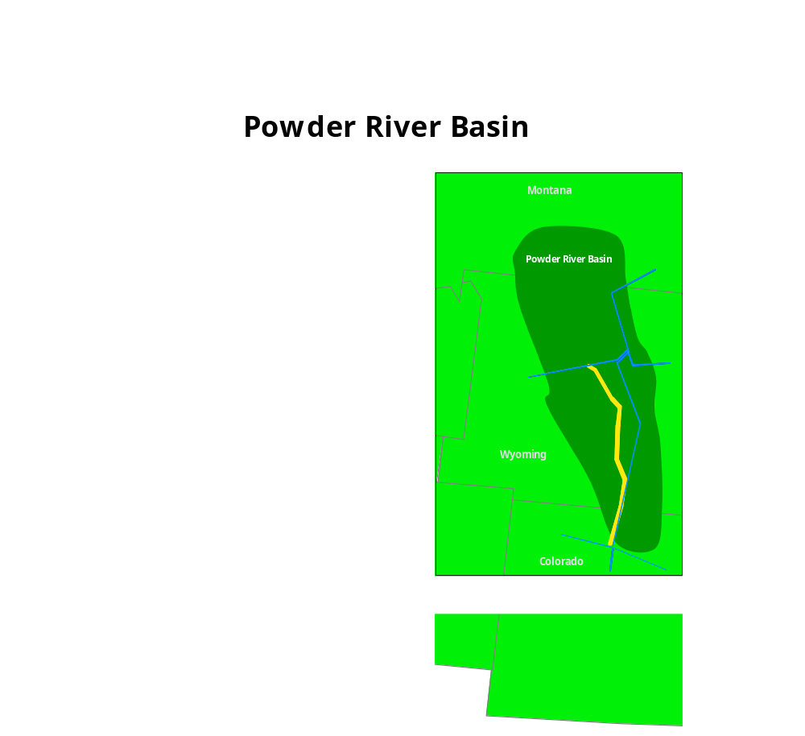
Powder River Basin
Natural Gas
Power
Coal
Crude Products
Emissions
Weather
Basin Dominated by Small to Mid-Sized Independent Producers
Enron is Providing Capital to Develop Gas Reserves and Build Gathering and Compression Systems
Creates New Volumes for Fort Union Pipeline in Which Enron has an Equity Interest
Strategically Positions Enron to Expand Services to Producers in Most Active Basin in U.S.
Pulp and Paper
Merchant
Investments
Ft. Union Gathering System
Interconnecting Pipelines

Slide 28
Enron’s Lead Market Position
Natural Gas Volumes
Enron
Aquila
PG&E
Duke
Coral
Dynegy
1
1997
5
NA
3
6
2
1998
1
2
3
4
6
5
3Q99 YTD
1
3
4
2
5
6
Power Volumes
Enron
AEP
Aquila
Southern
PG&E
Avista
1
6
4
8
NA
1997
NA
1998
1
NA
3
2
8
13
3Q99 YTD
1
2
3
6
5
4
Source: Natural Gas Week, Megawatt Daily, Gas Daily, Natural Gas Intelligence, Power Marketers Week
NA=Not Available

Slide 29
Enron North America
Premier Energy Merchant in North America
Network
Relationships
Assets
  Continental Scope
  Multi-Commodity
  Information
  Customers
  Suppliers/Developers
  Market Makers
  People
  Systems
  Physical

